Slide 1
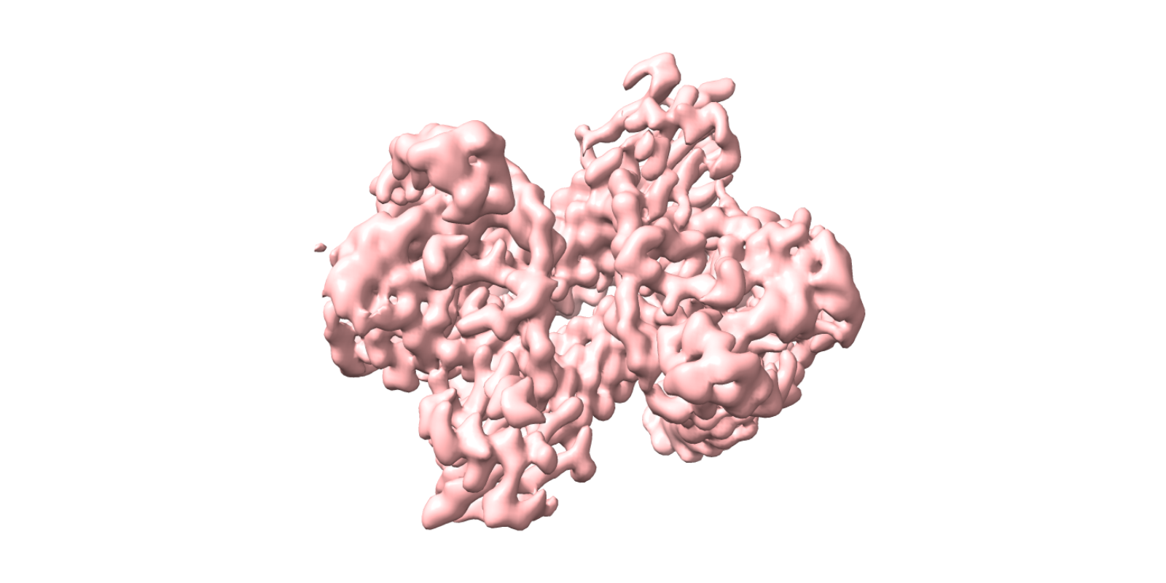

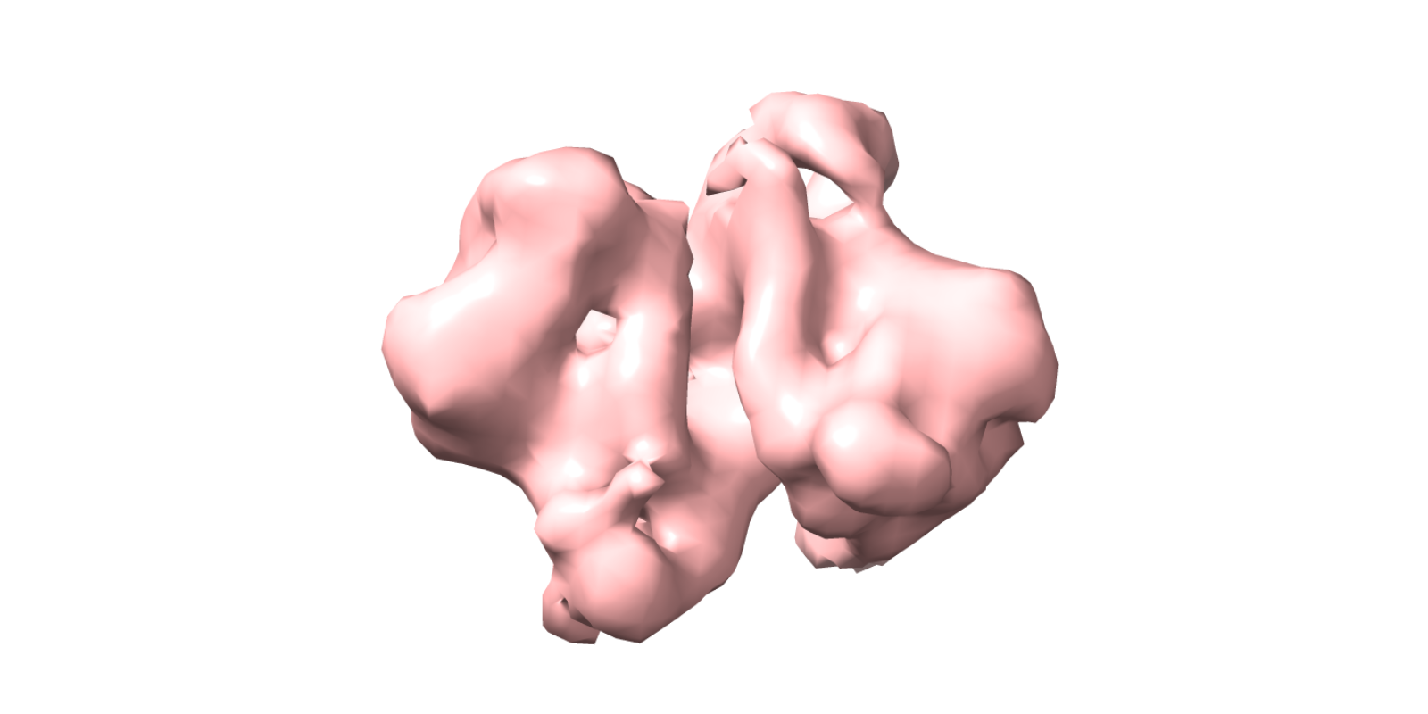
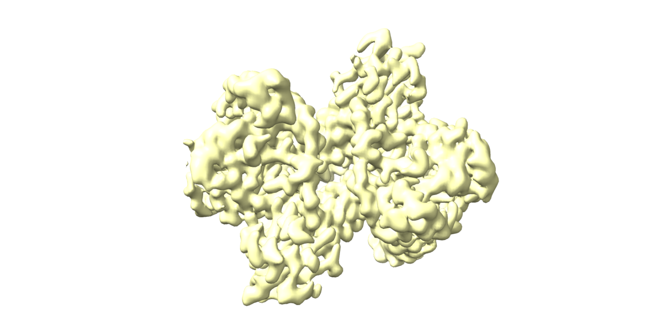
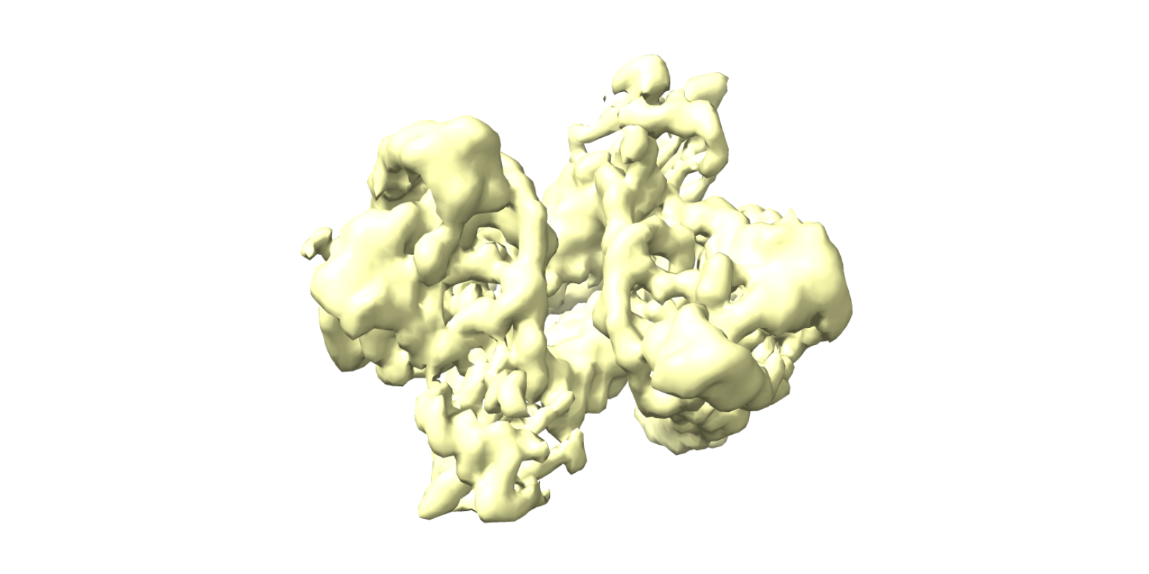
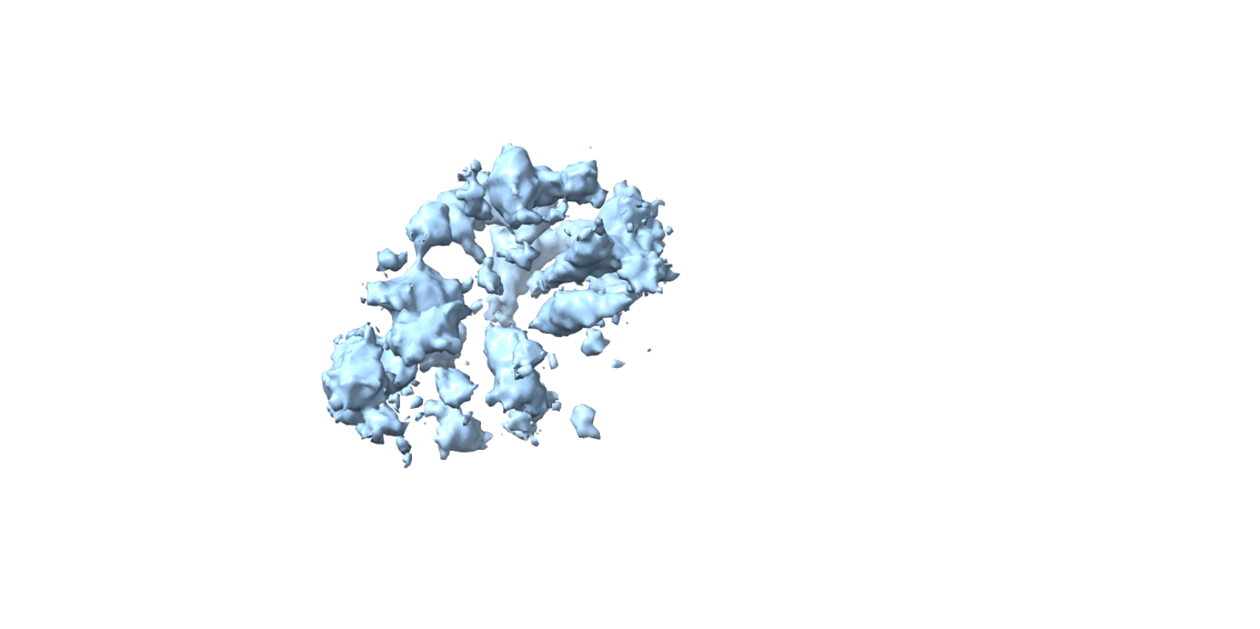
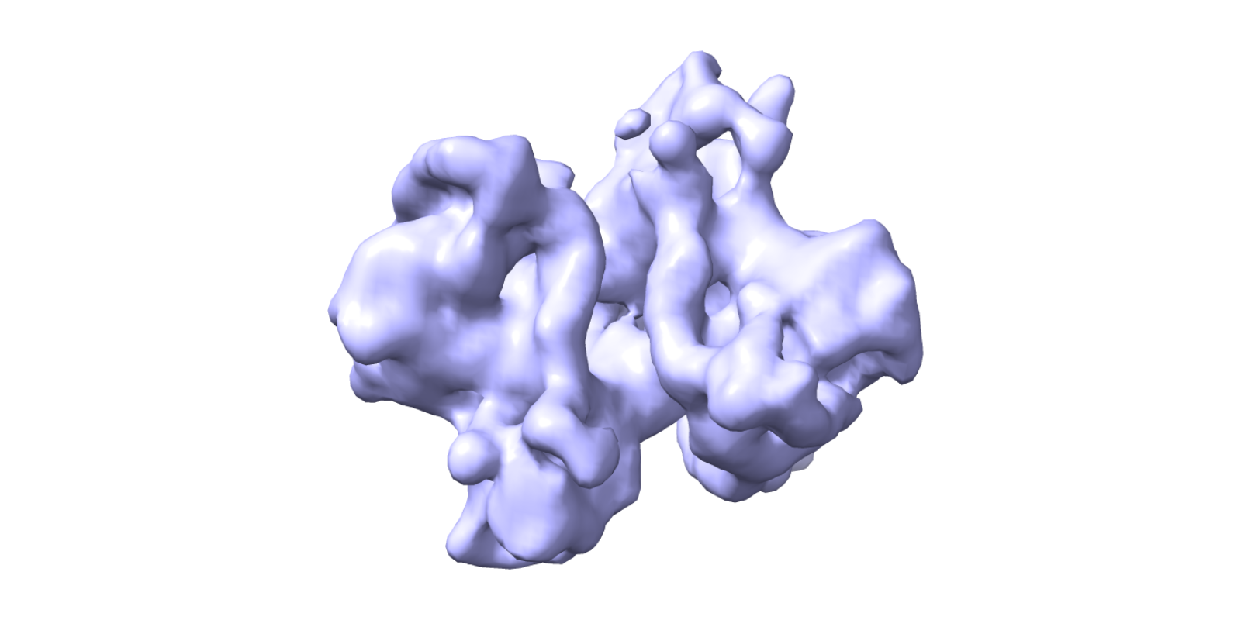
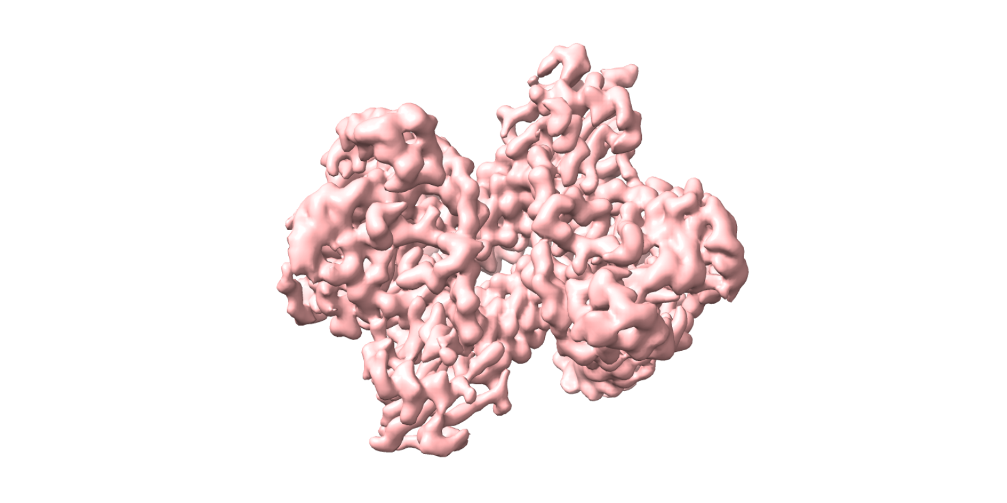
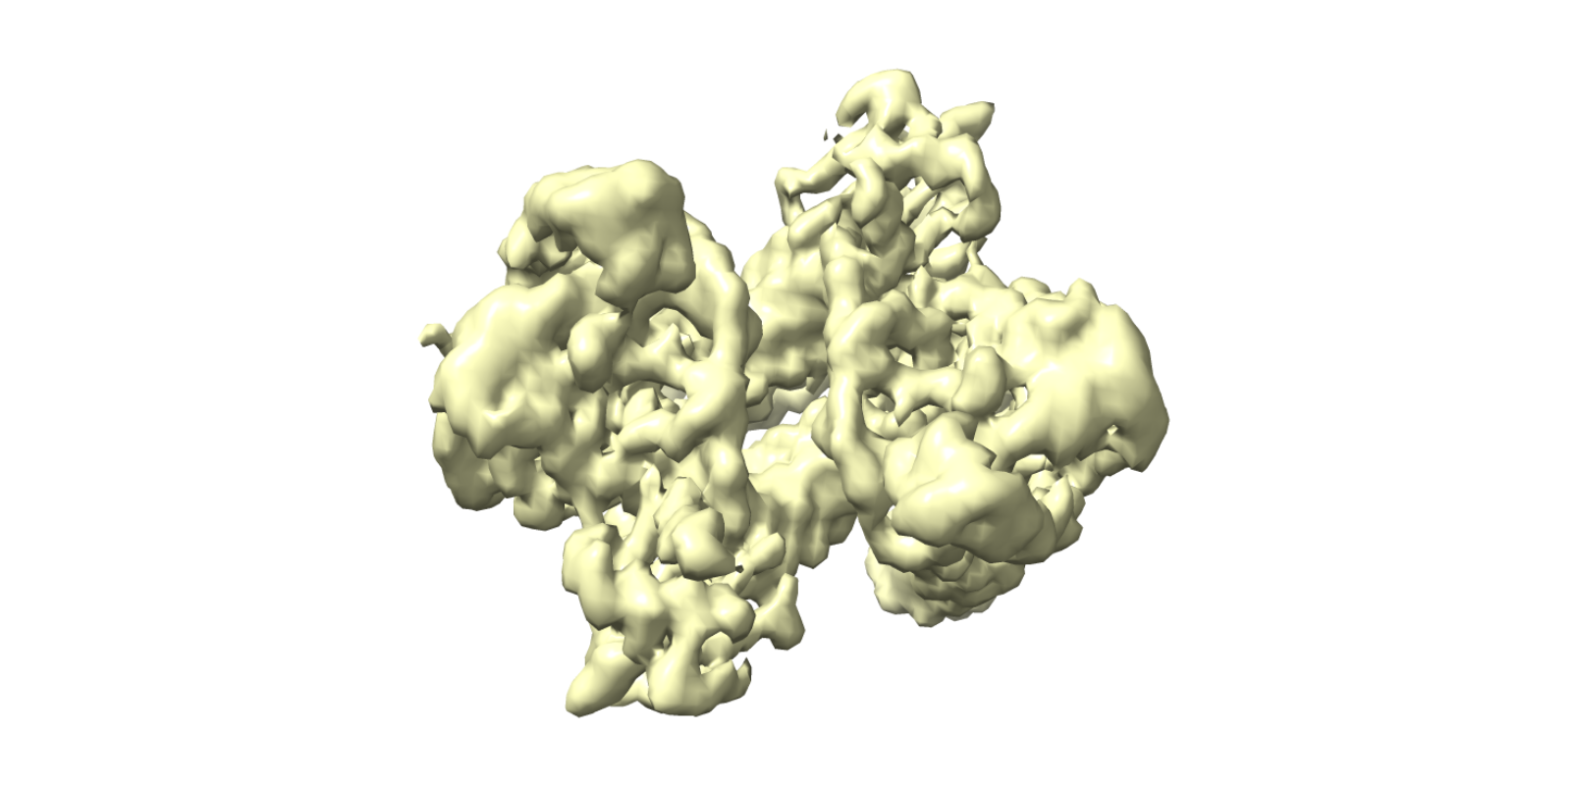
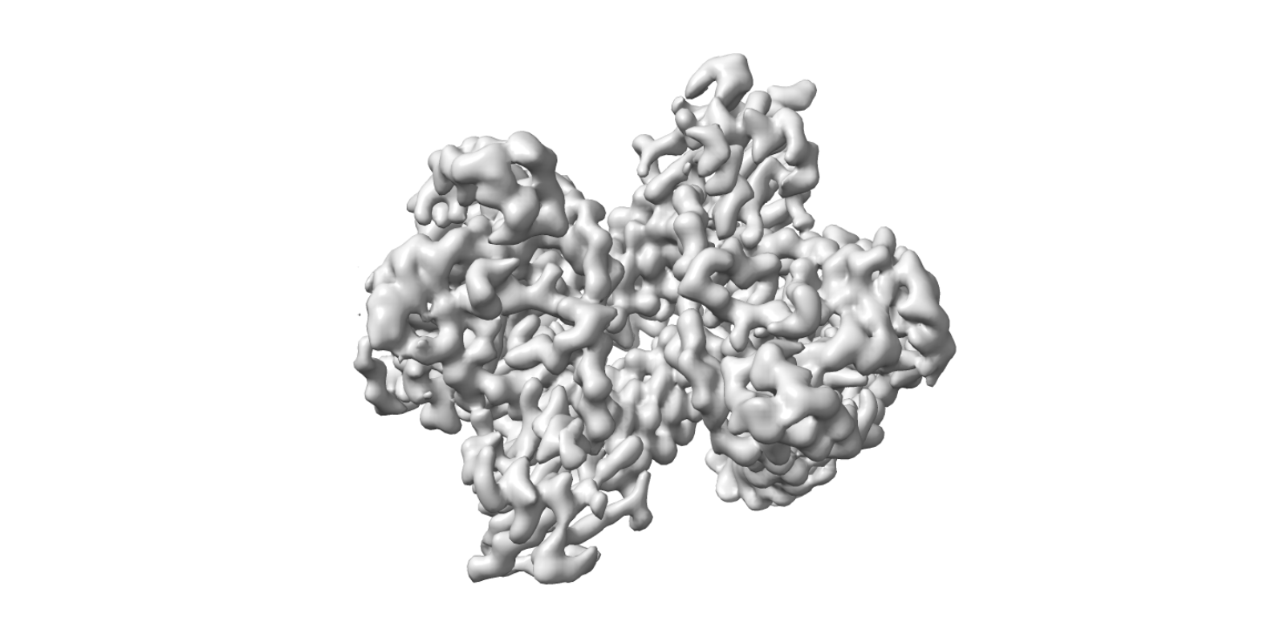
6,060 Micrographs
Auto pick
164,291 particles
2D class selection
Non-uniform refinement
12,259 selected
6 classes
378,677 particles
Ab-initio reconstruction
Non-uniform refinement
50%
58,048 particles
378,677 particles
Hetero refinement
Ab-initio reconstruction
77%
766,560 particles
4.2%
378,677 particles
Ab-initio reconstruction
Homo Reconstruct
47%
590,421 particles
209,127 particles
Hetero refinement
Local refinement
64.1%
590,421 particles
209,127 particles
所有地图已对齐至参考 J41/volume · 手性检查: 2 个已翻正，7 个一致 · 视角 y-90 · CryoSmart Workflow Figure (ChimeraX aligned)

